Slide 1

R
- Recency TAB
t
Site Data Collection Using Tablet

Slide 2

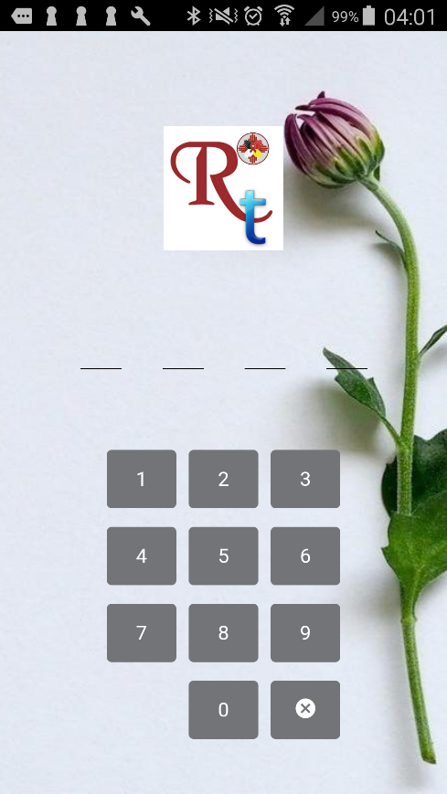
BACKGROUND
Recency is a POC test and will be deployed at sites in limited setting.
Confirmation of recency requires VL test performed at remote lab.
Minimizing TOT and tracking samples is key to successful implementation.
Monitoring quality indicators for recency test is very critical
R_{t} Recency Tab is light weight solution to capture recency data at point of testing and help in reducing turnaround time.

Slide 3
OUR
GOALS
1
Easy to Use
An application which is easy to use with minimal training.
R_{t} – Rececny TAB
2
Works in Limited Resource Setting
System can work on any smart device like tablet or cell phone.
3
Monitor Quality
Capture recency tests and QC data.
4
Security and Interoperability
Provide secured data storage , transmission, and API for data integration with other surveillance and reporting system.

Slide 4
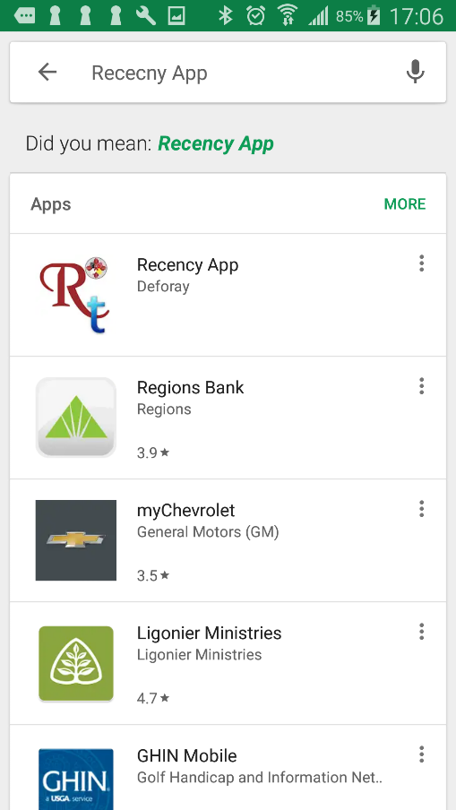
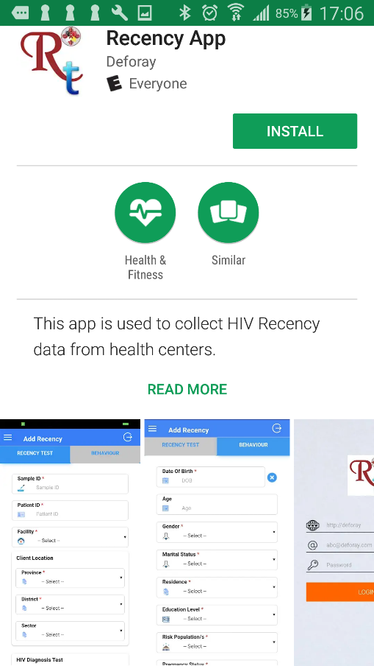
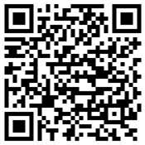
INSTALL APPLICATION
Search Rececny App in Google App
OR
Scan QR Code

Slide 5
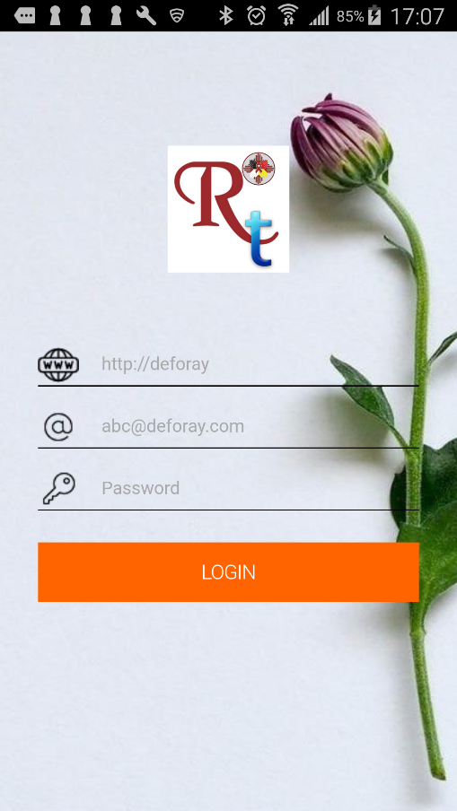
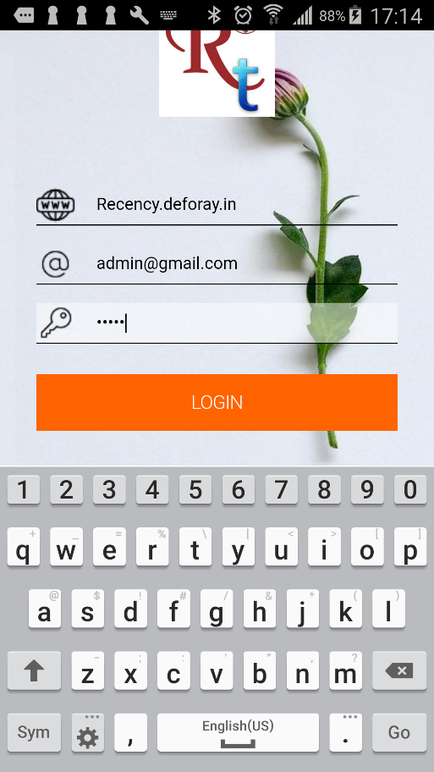
CONFIGURE APPLICATION_{1/2}
XXXXXXXXXXXXXXXX
Configure Server
Add Server Information:
Server Information
Your User ID (e-mail)
Server Password
Server Information:
https://tablet.hivrecency.com
demo@gmail.com
12345

Slide 6
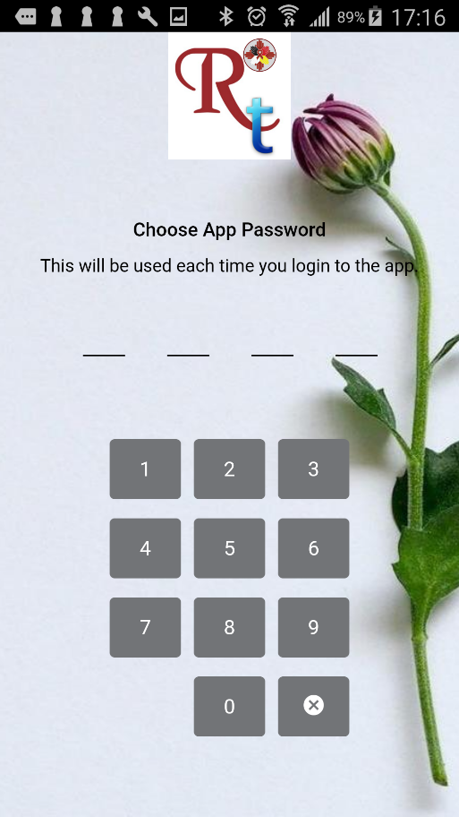
CONFIGURE APPLICATION_{2/2}
Add Local App Password
Adding more security to restrict use of application by any one using tablet
Every county will have own server
Every User is limited for certain Health Facility
Every user will see his own data

Slide 7
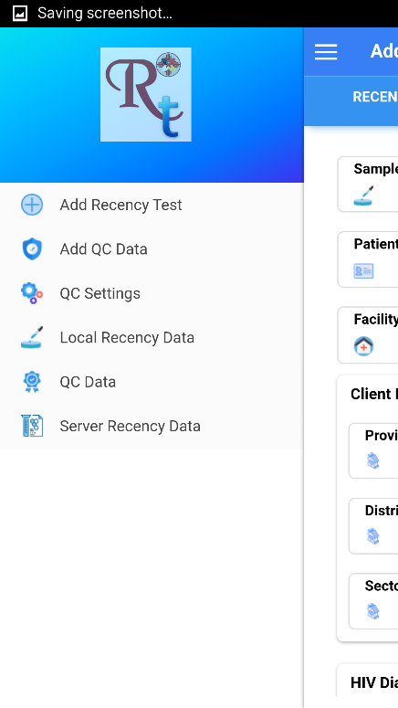
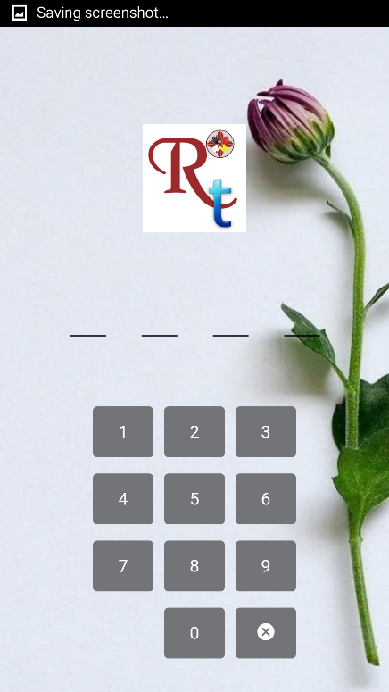
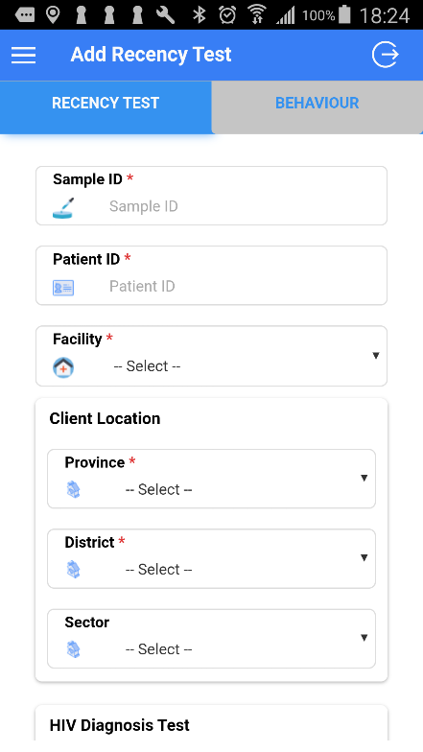
Persentation Power Point
LOGIN
RECENCY TEST
USING
RECECNY APP_{1/7}
Menu

Slide 8
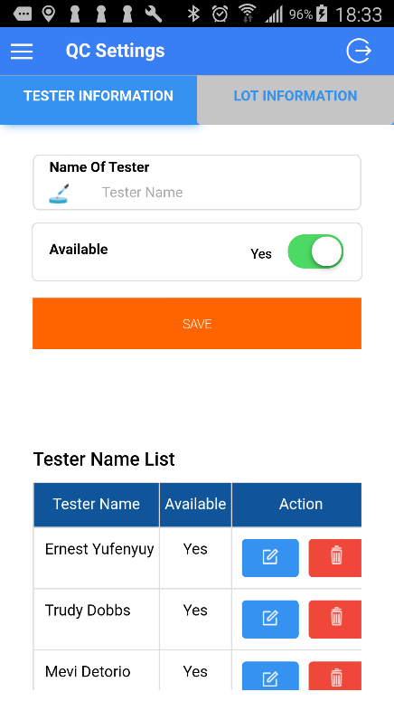
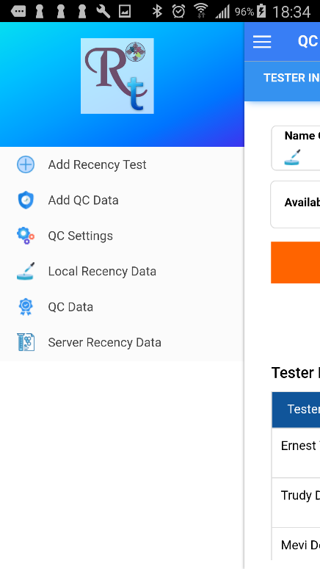
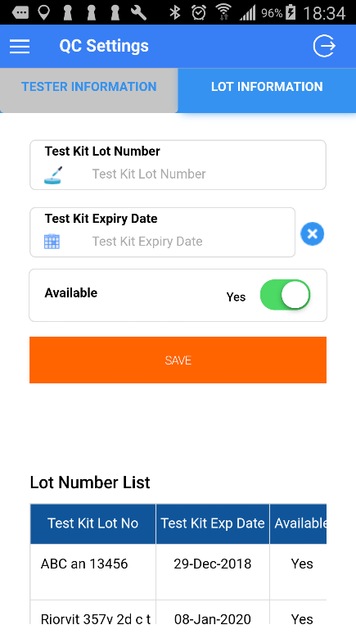
Persentation Power Point
SITE INFORMATION
LOT INFORMATION
USING
RECECNY APP_{2/7}
TESTER INFORMATION

Slide 9
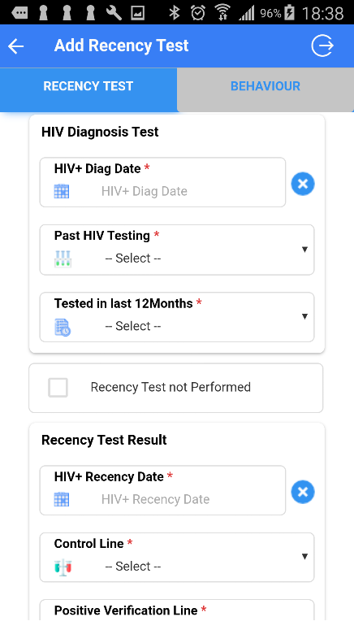
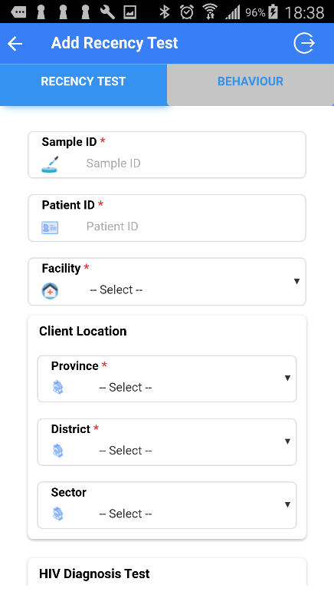
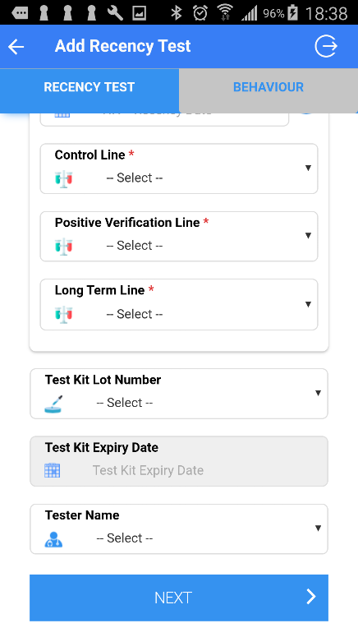
Persentation Power Point
ADD RECENCY TESTS
ADD RECECNY TESTS
Add Check to Improve Data Quality
Lot Number Verification
Tester Name
No Future Date
Rececny Algorithm
Facility Name and District Information
Skip Patterns
USING
RECECNY APP_{3/7}
ADD RECENCY TESTS

Slide 10
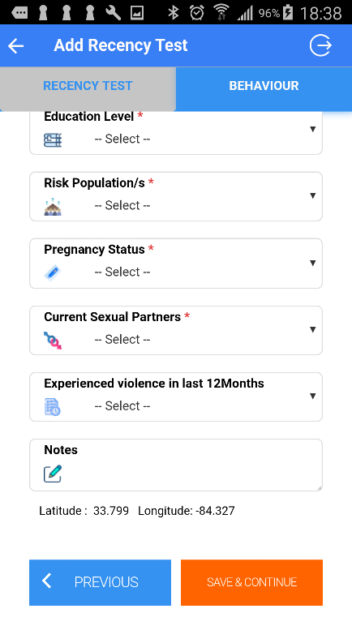
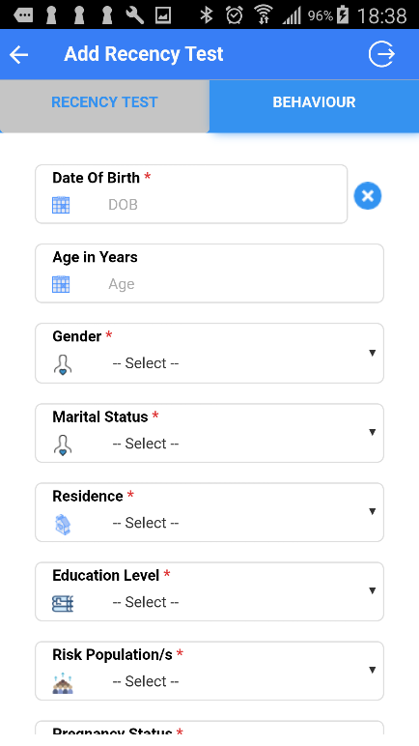
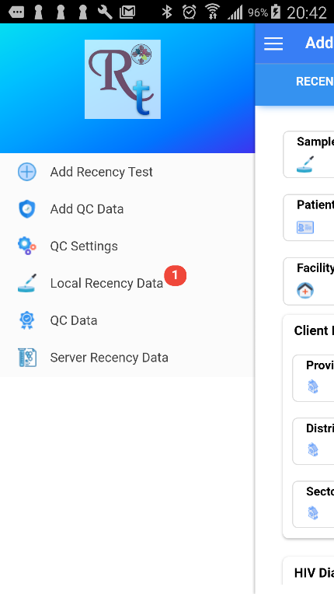
Persentation Power Point
ADD BEHAVIOUR DATA
ADD BEHAVIOUR DATA
Add Check to Improve Data Quality
Lot Number Verification
Tester Name
No Future Date
Rececny Algorithm
Facility Name and District Information
Skip Patterns
USING
RECECNY APP_{4/7}
ADD BEHAVIOUR DATA

Slide 11
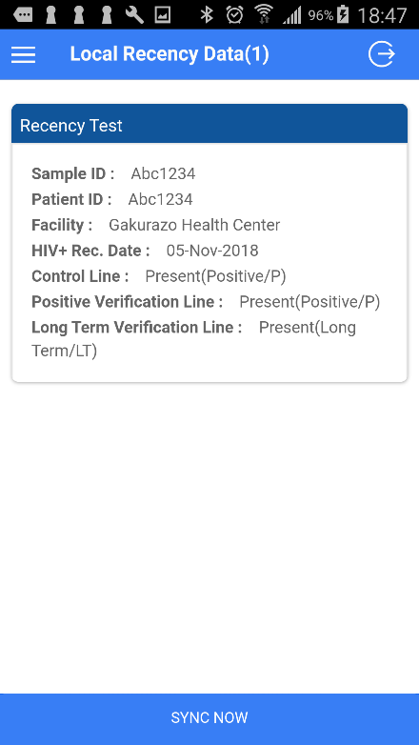
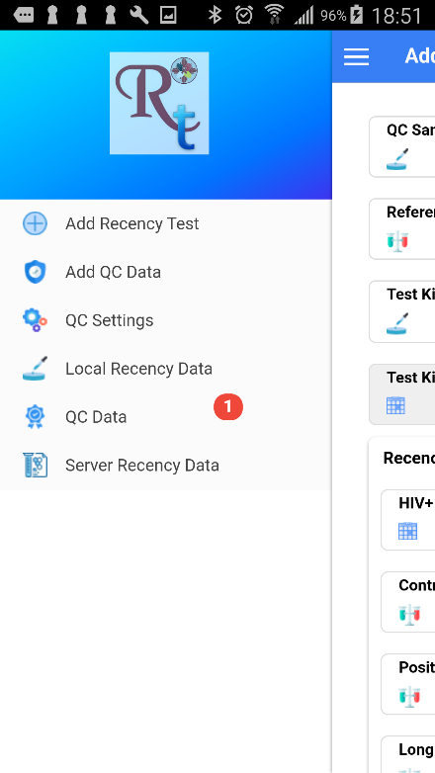

Persentation Power Point
UPLOAD TO SERVER
UPLOAD TO SERVER
USING
RECECNY APP_{5/7}
UPLOAD TO SERVER

Slide 12
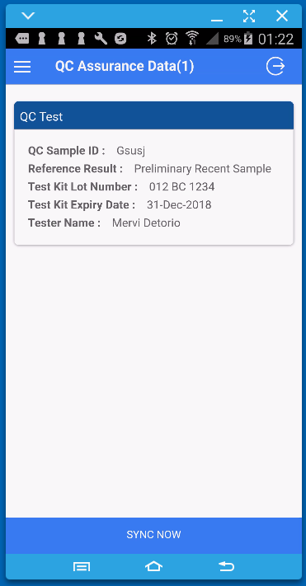
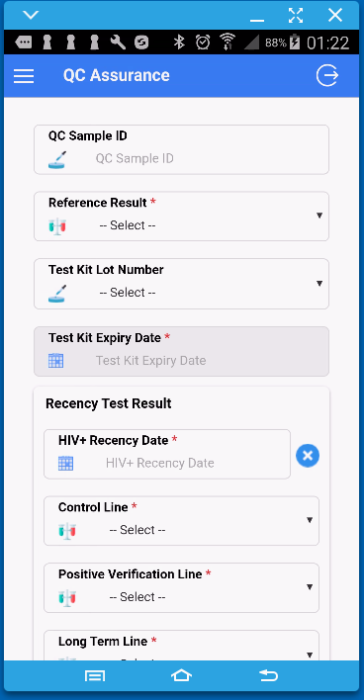
ADDING QC INFORMATION
ADDING QC INFORMATION
USING
RECECNY APP_{6/7}
ADDING QC INFORMATION

Slide 13
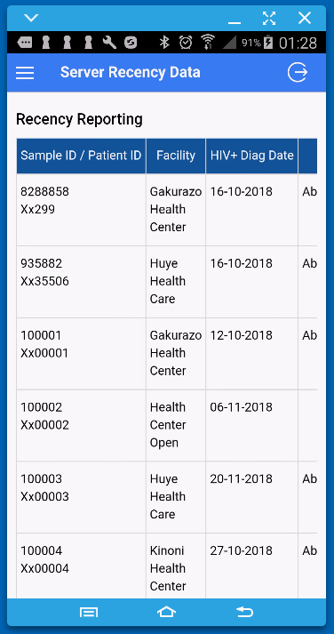
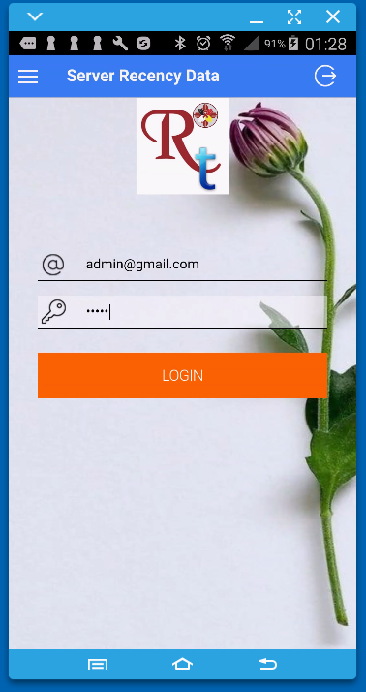
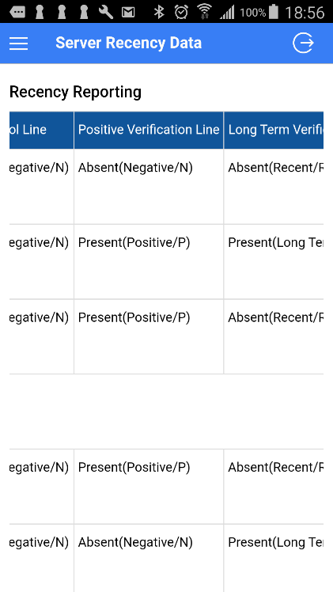
Persentation Power Point
VIEW PAST TESTS
RECECNY RESULTS
USING
RECECNY APP_{7/7}
VIEW PAST TEST

Slide 14
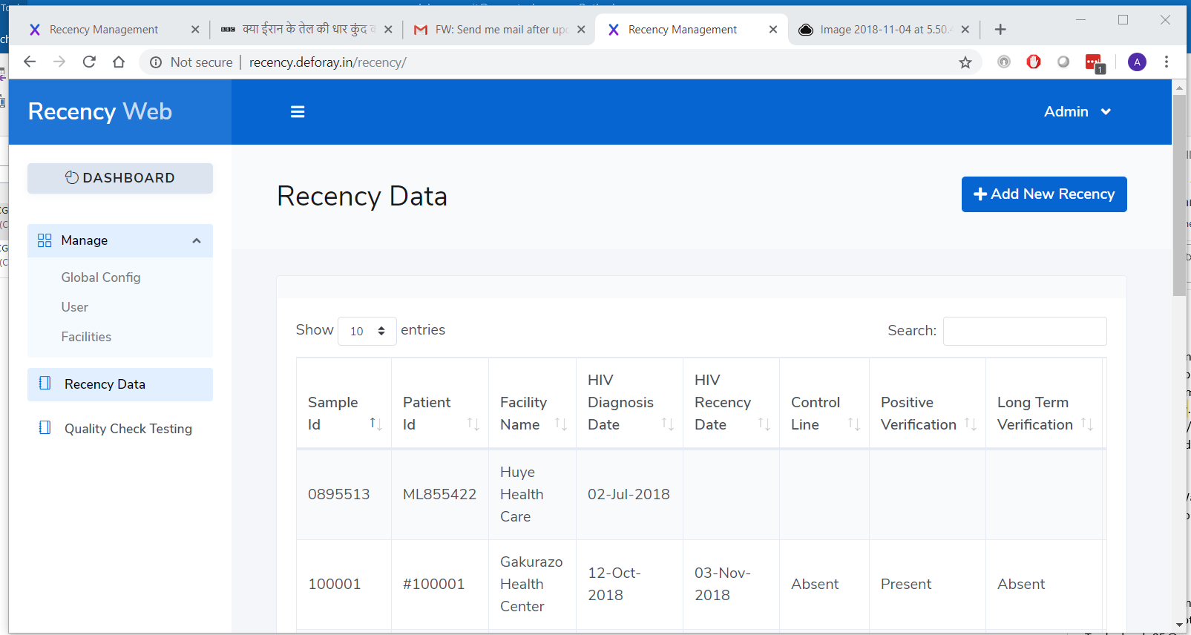
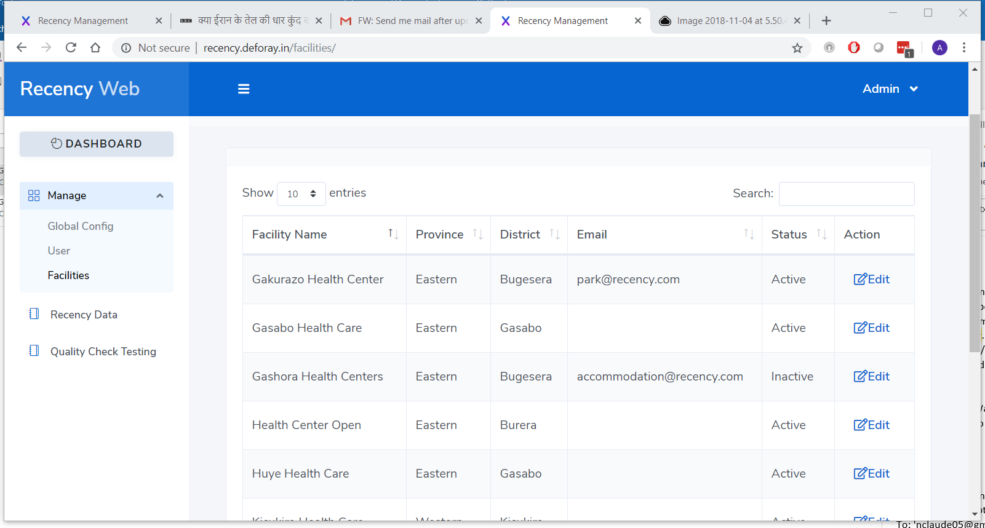
DATA ON
SERVER
Go to web browser:
https://tablet.hivrecency.com
Use:
login: demo@gmail.com
Password: 12345
To view your data

Slide 15

THANK YOU

